Slide 1
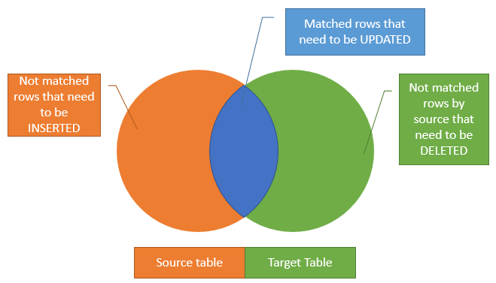
SQL Merge Statement
Suppose, we have two table called source and target tables, and you need to update the target table based on the values matched from the source table. There are three cases:
The source table has some rows that do not exist in the target table. In this case, you need to insert rows that are in the source table into the target table.
The target table has some rows that do not exist in the source table. In this case, you need to delete rows from the target table.
The source table has some rows with the same keys as the rows in the target table. However, these rows have different values in the non-key columns. In this case, you need to update the rows in the target table with the values coming from the source table.

Slide 2
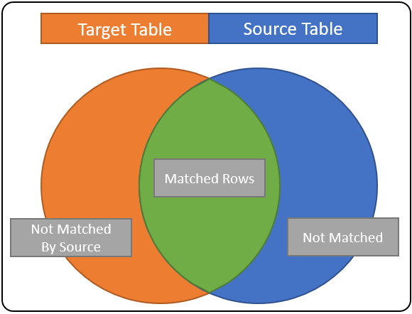
A merge condition results in one of three states:
1) MATCHED,
2) NOT MATCHED
3) NOT MATCHED BY SOURCE.
Let’s go over what the various conditions mean:
MATCHED – These are rows satisfying the match condition. They are common to both the source and target tables. In our diagram, they are shown as green. When you use this condition in a merger statement you; most like being updating the target row columns with source Table column values.
NOT MATCHED – This is also known as NOT MATCHED BY TARGET; these are rows from the source table that didn’t match any rows in the target table. These rows are represented by the blue area above. In most cases that can be used to infer that the source Rows should be added to the target Table.
NOT MATCHED BY SOURCE – these are rows in the target table that were never match by a source record; these are the rows in the orange area. If your aim is to completely synchronize the target Table data with the source, then you’ll use this match condition to DELETE rows.

Slide 3
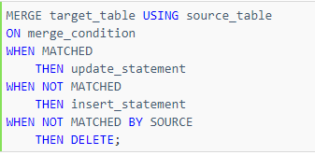
If we use the INSERT, UPDATE, and DELETE statement individually, you have to construct three separate statement to update the data to the target table with the matching rows from the source table.
However, SQL Server provides the MERGE statement to allows you to perform three actions at the same time. The following shows the syntax of the MERGE statement:

Slide 4
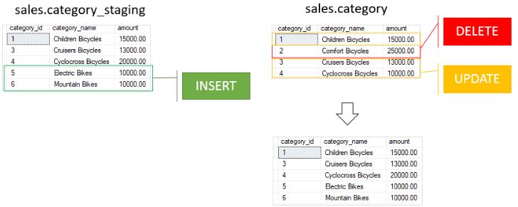
CREATE TABLE category ( category_id INT PRIMARY KEY,
category_name VARCHAR(255) NOT NULL,
amount DECIMAL(10 , 2 )
);
INSERT INTO category(category_id, category_name, amount)
VALUES(1,'Children Bicycles',15000),
(2,'Comfort Bicycles',25000),
(3,'Cruisers Bicycles',13000),
(4,'Cyclocross Bicycles',10000);
CREATE TABLE category_staging ( category_id INT PRIMARY KEY,
category_name VARCHAR(255) NOT NULL,
amount DECIMAL(10 , 2 )
);
INSERT INTO category_staging(category_id, category_name, amount)
VALUES(1,'Children Bicycles',15000),
(3,'Cruisers Bicycles',13000),
(4,'Cyclocross Bicycles',20000),
(5,'Electric Bikes',10000),
(6,'Mountain Bikes',10000);
MERGE category t
USING category_staging s
ON (s.category_id = t.category_id)
WHEN MATCHED
THEN UPDATE SET
t.category_name = s.category_name,
t.amount = s.amount
WHEN NOT MATCHED BY TARGET
THEN INSERT (category_id, category_name, amount)
VALUES (s.category_id, s.category_name, s.amount)
WHEN NOT MATCHED BY SOURCE
THEN DELETE;

Slide 5
In this example, we used the values in the category_id columns in both tables as the merge condition.
First, the rows with id 1, 3, 4 from the sales.category_staging table matches with the rows from the target table, therefore, the MERGE statement updates the values in category name and amount columns in the sales.category table.
Second, the rows with id 5 and 6 from the sales.category_staging table do not exist in the sales.category table, so the MERGE statement inserts these rows into the target table.
Third, the row with id 2 from the sales.category table does not exist in the sales.sales_stagingtable, therefore, the MERGE statement deletes this row.
As the result of the merger, the data in the sales.category table is fully synchronized with the data in the sales.category_staging table

